Slide 1

Level 4 Project: Reflective Learning Tool
James Orr (2550508o)

Slide 2
Running Order
Introduction and Motivation
Demo
Key Design Points
Evaluation
Learner Study
Lecturer Study
Future Works

Slide 3
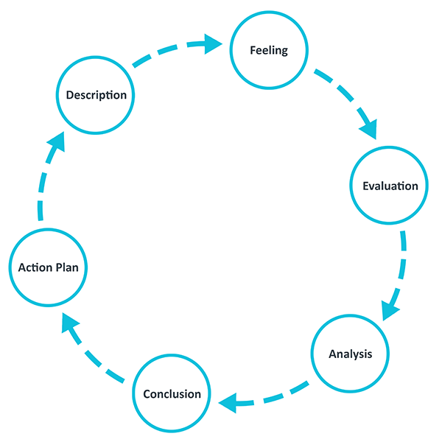
Introduction and Motivation
Who is the tool for?
Learners
Teachers
Reflection in and on-action
Reflection are fleeting
The tool required a system to capture reflections quickly
Reflecting after the situation
Reflective Parameters:
Time
Emotions
Reflective Note
Overall reflection
Gibbs’ (1988) Reflective Learning Cycle

Slide 4
Demo

Slide 5
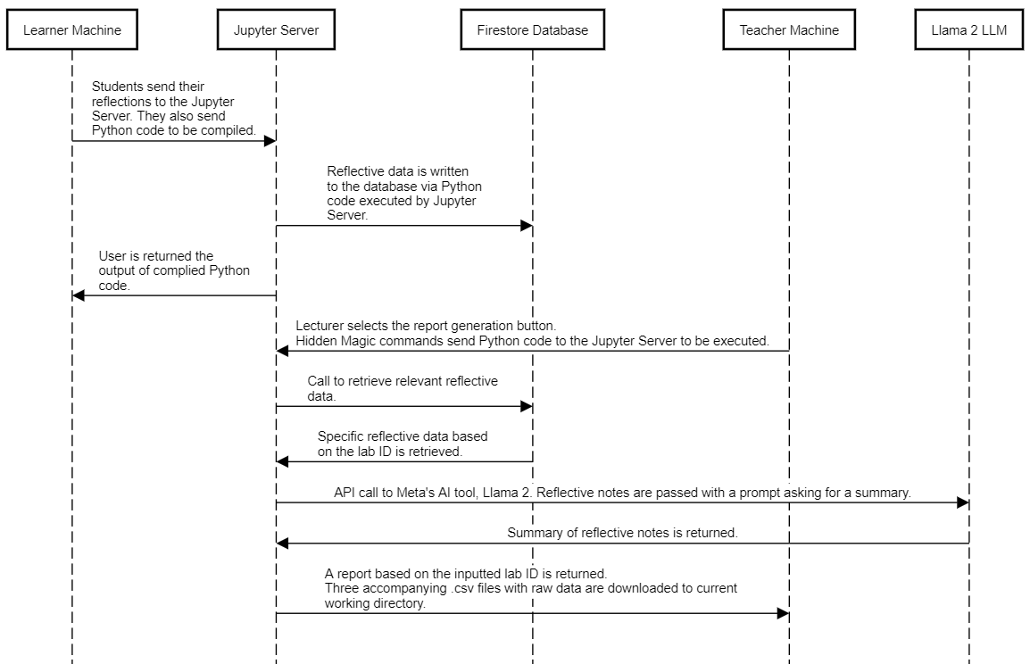
Key Design Points
NBExtension
JavaScript front-end
User inputs from cells (Markdown and Code) could not be saved
Magic Commands
Allowed Jupyter server-side Python execution
Mechanism to save user reflections
LLM
Llama 2.0 (Meta) API: Reflective notes are passed with a prompt and the LLM summarises the common themes

Slide 6
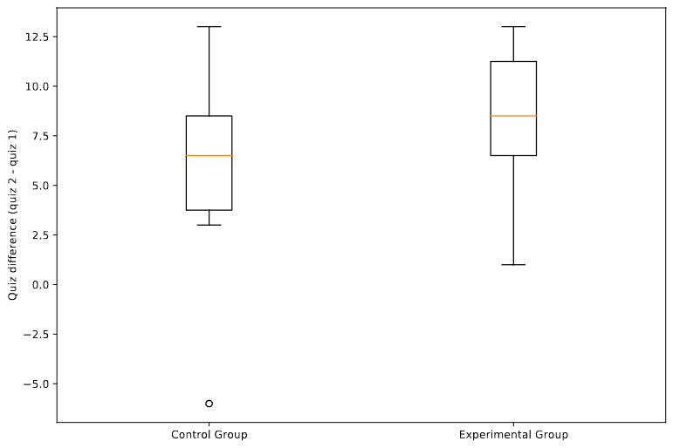
User Study
Between subject learner study conducted over five weeks
Control group used the standard Jupyter Notebook toolbar
Experimental group used the Reflective Learning Tool
Quiz results difference show no statistical difference

Slide 7
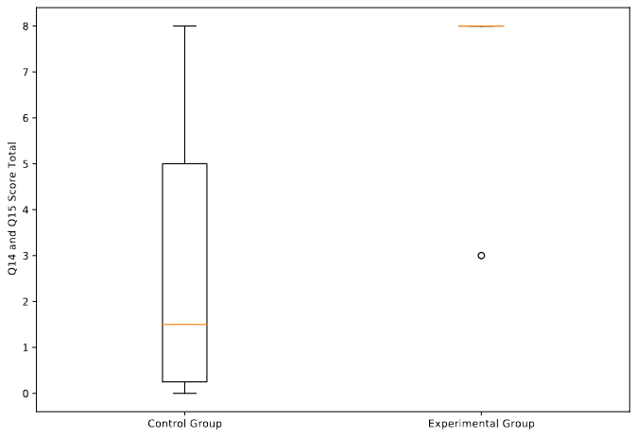
User Study
Post-course quiz Q14 and Q15
These questions covered topics which were not covered in the course
Experimental group applied their learning onto new types of questions better than control
P-value = 0.02
Data dredging concerns due to low sample size (N = 12)

Slide 8
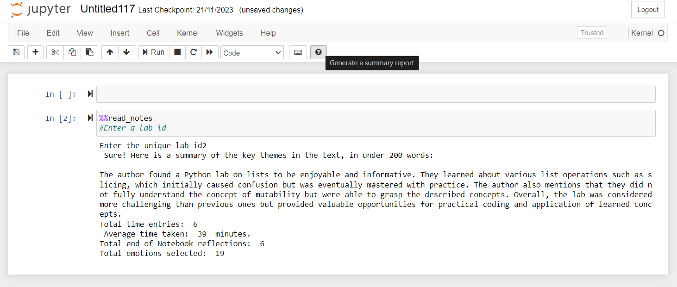
Lecturer Study
The summarised report was accurate
Lecturer indicated they would use the tool
The report prompted the lecturer to suggest changes to the course – indicating the report could be used to help lectures self-reflect on their teaching

Slide 9
Future Work
Further evaluation:
Large study
More lecturers
Further extensions:
Inclusion of Latex or mechanism to record calculations as part of a reflective note
Using previous reflections to recap previous labs

Slide 10
Wrap-up
Acknowledgements
Questions

